Slide 1

Introduction to Webdriver

Slide 2
What is Webdriver
WebDriver is a tool for automating testing web applications.
Popularly known as Selenium 2.0
It performs Multi-browser testing including improved functionality for browsers which is not well-supported by Selenium RC (Selenium 1.0)
WebDriver also enables you to use a programming language in creating your test scripts (not possible in Selenium IDE).
You can now use conditional operations like if-then-else or switch-case
You can also perform looping like do-while.

Slide 3
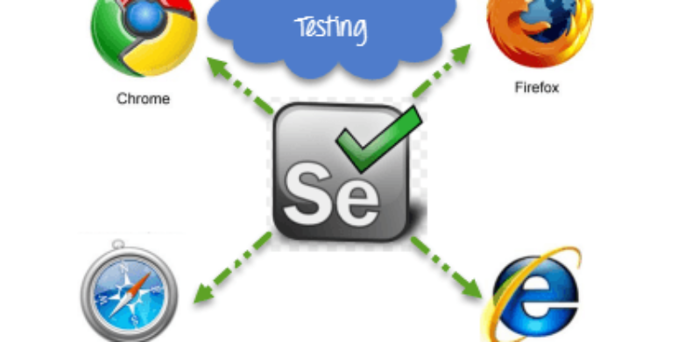
MultiBrowser Support

Slide 4
Features of Webdriver
It can handle multiple frames, multiple browser windows, popups, and alerts.
It can handle advanced user navigation such as drag-and-drop.
It works well with complex page navigation
It can handle AJAX-based UI elements.

Slide 5
Programming Languages
Following programming languages are supported by WebDriver
PHP
Java
.Net
Python
Perl
Ruby

Slide 6
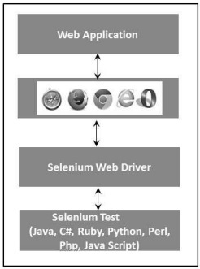
Architecture of Webdriver
It controls the browser from the OS level
It directly interacts with the browser

Slide 7
Thanks

